Slide 1
The New Testament Church Matthew 16:13-18

Slide 2
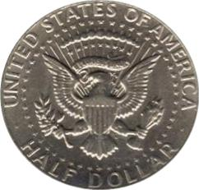
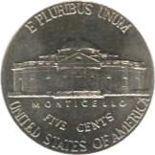
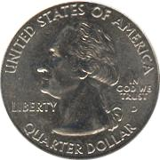
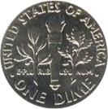
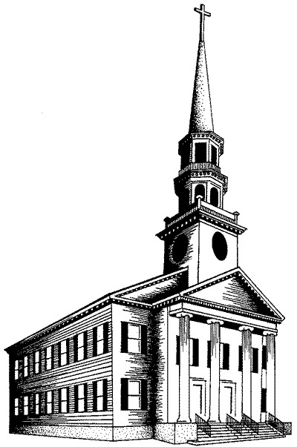
Denominational Concept
SO:
Catholic
Lutheran
Baptist
Methodist
7th Day Adventist
Mormon
Jehovah’s Witness
Invisible Church

Slide 3
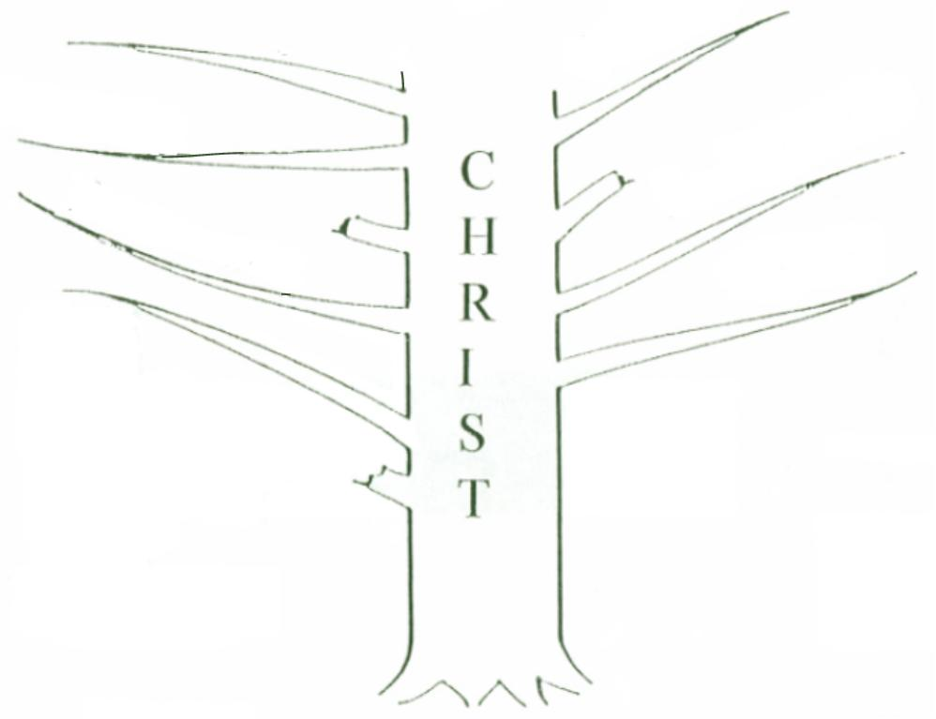
Mormon
Catholic
Lutheran
Methodist
7th Day Adventist
Jehovah’s Witness
Baptist
Not This:
John 15:5 – “I am the vine … Ye are the branches”

Slide 4
Peter
James
Richard
Chris
Micky
Kaitlyn
But This:
John 15:5-6 – “He who abides in me … If anyone does not abide in me … he is cast out …”

Slide 5
The New Testament Church
Founded upon Jesus Christ, the Son of God. Matthew 16:18; 1 Corinthians 3:11; 1 Corinthians. 2:2
Began in Jerusalem about 33 A.D. Isaiah 2:3; Matthew 3:2; Matthew 4:17; Mark 1:14-15; Luke 10:9; Matthew 10:7; Mark 9:1; Luke 24:44ff; Acts 1:6-8; 2:1-4,47; 11:15
Christ is its head and only source of authority. Matthew 28:19; Ephesians 1:22-23; Matthew 21:23-27; Matthew 7:21; Luke 6:46

Slide 6
The New Testament Church
Organized after the divine pattern.
Philippians 1:1
Elders: Acts 14:23; 20:28; 1 Peter 5:1ff; 1 Timothy 3:1-7; Titus 1:5-7
Deacons: 1 Timothy 3:8-13
Members: 1 Corinthians 12:12ff

Slide 8
Departure In Organization

Slide 10
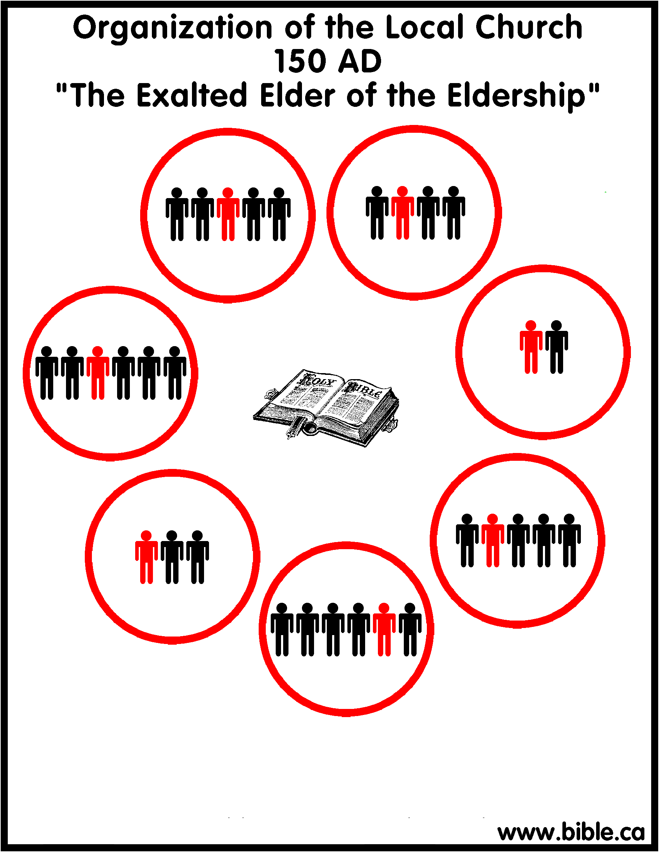
Notes:
150-250AD: "The Episcopal Presbytery"
150 AD: "The rise of the exalted elder" At first, a single elder (also known as a bishop) began to be exhaled above the other bishops. (also known as an elder)
200 AD: "The rise of the Episcopal Presbytery" Local churches began to be governed by a single bishop/overseer (Episcopate) over a group of elders (Presbytery). The exhaled elder of the 150 AD became a distinct office from the eldership.
250 AD: "The rise of the Diocesan Bishop". Finally this bishops of larger churches began to exercise control over smaller churches. Bishops began to control not only their own local churches, but a group of local churches within a geographic area that is known today as a "diocese".

Slide 11
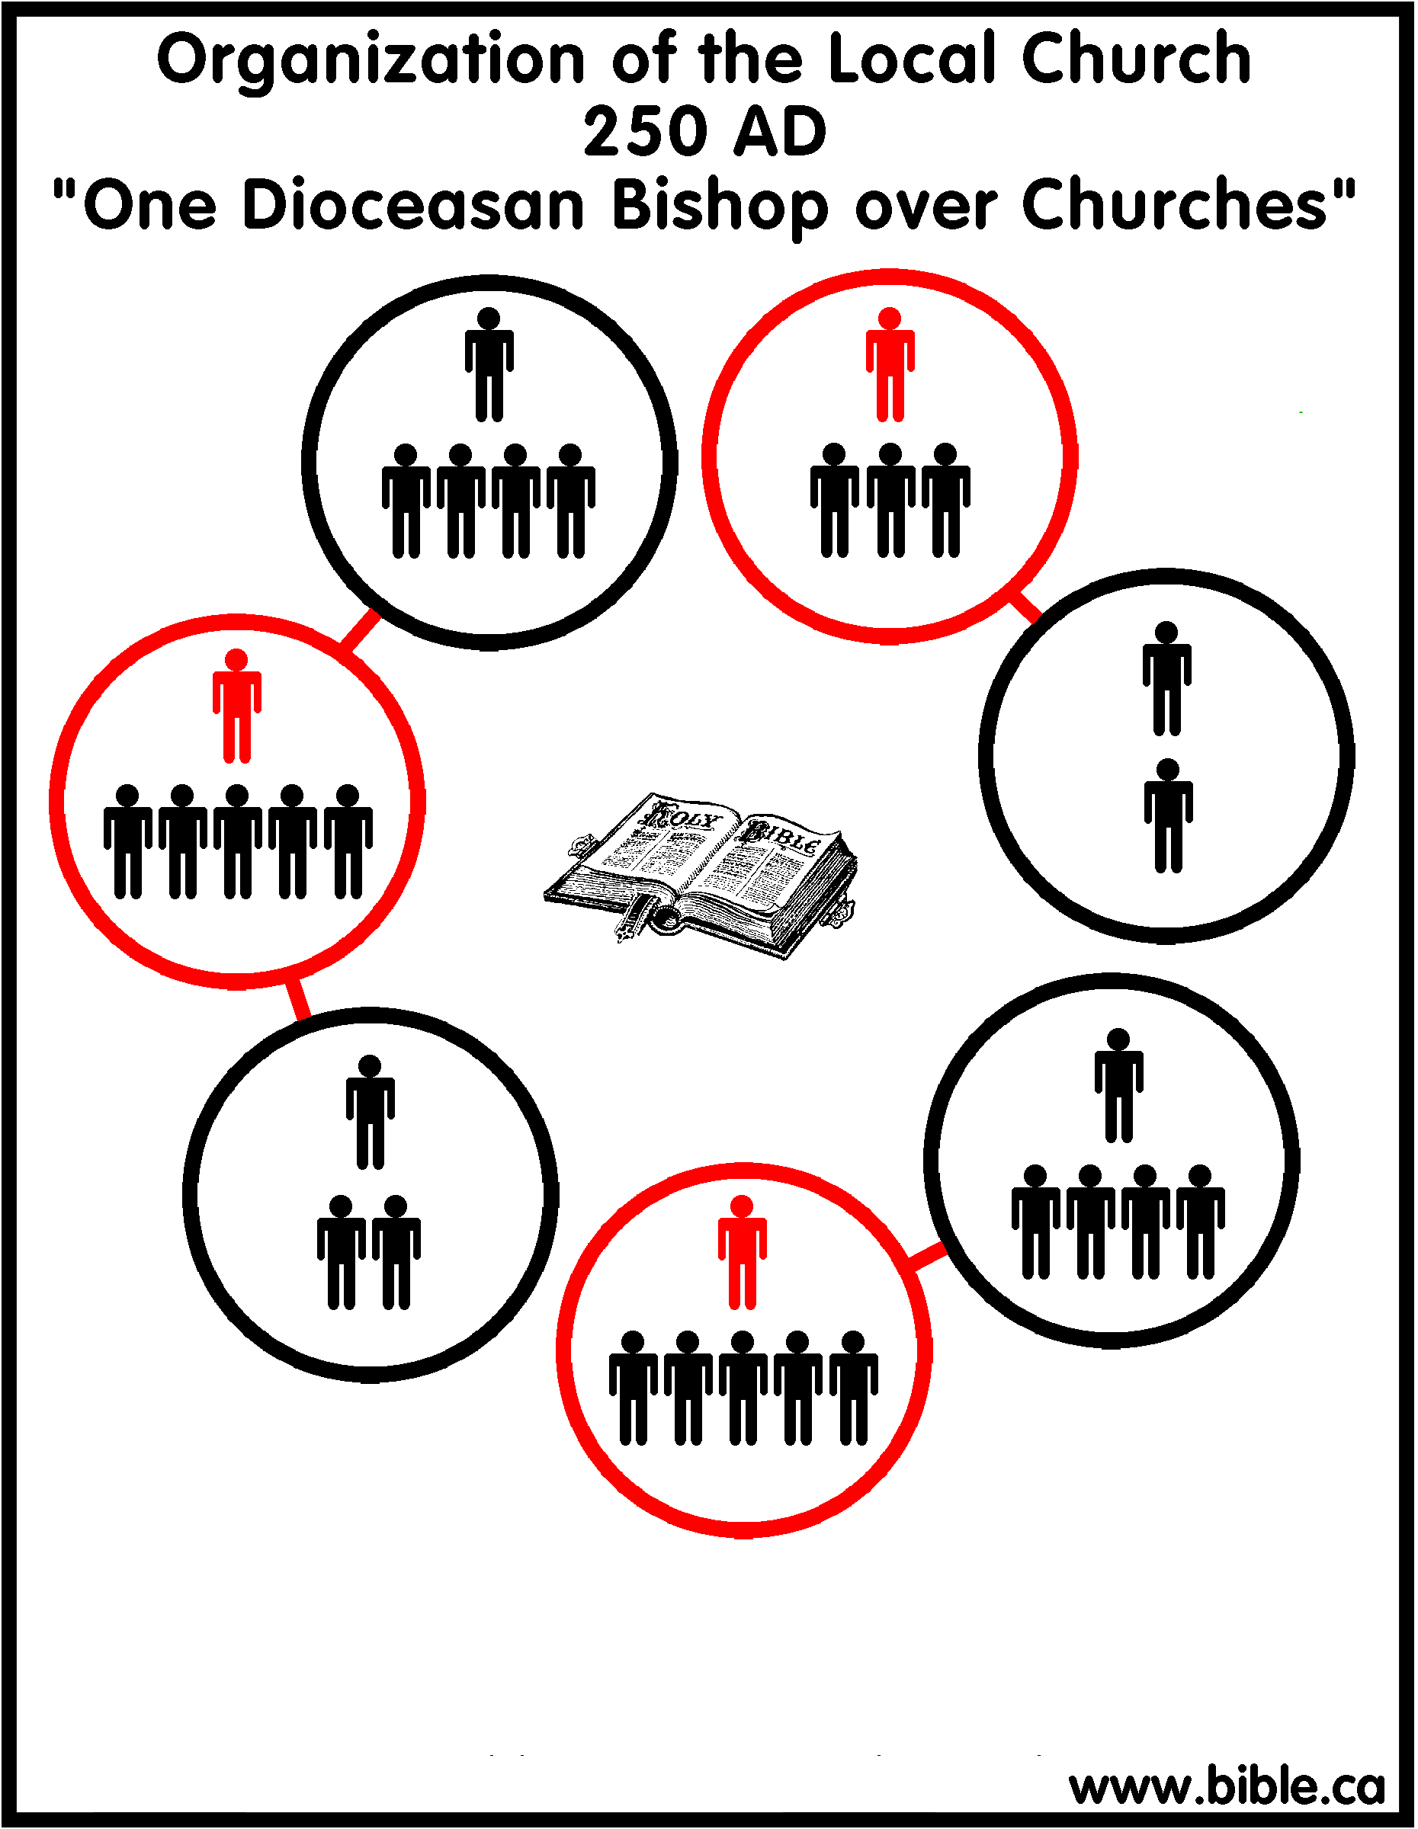
Notes:
Introduction: 250-451AD
The period of the 5 Patriarchs: The oligarchic diocesan episcopate. Three changes take place in this era.
250 AD: "The rise of diocesan bishops." One bishop began to rule a small group of churches in addition to his own local church. This was documented in the previous study. Click here for more: Outline: 150-250 AD
300 AD: "The rise of metropolitans." These men were nothing more than the diocesan bishops from the large and important cities that began to rule over the bishops of the smaller cities. Now you have bishops over bishops. Interesting, the Roman Catholic church later simplified its organization to only three levels, so that all bishops were under a single metropolitan, (which grew into a Patriarch), which they called, The Pope", or the bishop of Rome. The Eastern Orthodox church today retains this additional level of government, whereas the Roman Catholic system combined metropolitans and patriarchs into the single office of pope. In 325, the Nicene creed tells us there were 3 main metropolitans. Catholic organization today.
381 AD: "The rise of 5 patriarchs." Patriarchs grew directly out of metropolitans. Patriarch is directly equivalent to the office of "pope". The Roman Catholic church as a single Patriarch today which they call the "Pope" and the Eastern Greek Orthodox church has 14 Patriarchs which function as autocephalous (independent and autonomous) popes. Of the 14 Patriarchs in the Orthodox church today, only the Patriarch of Alexandria, calls himself "His Beatitude, Pope and Patriarch of Alexandria", whereas most are merely called, Patriarchs. Orthodox organization today.

Slide 12
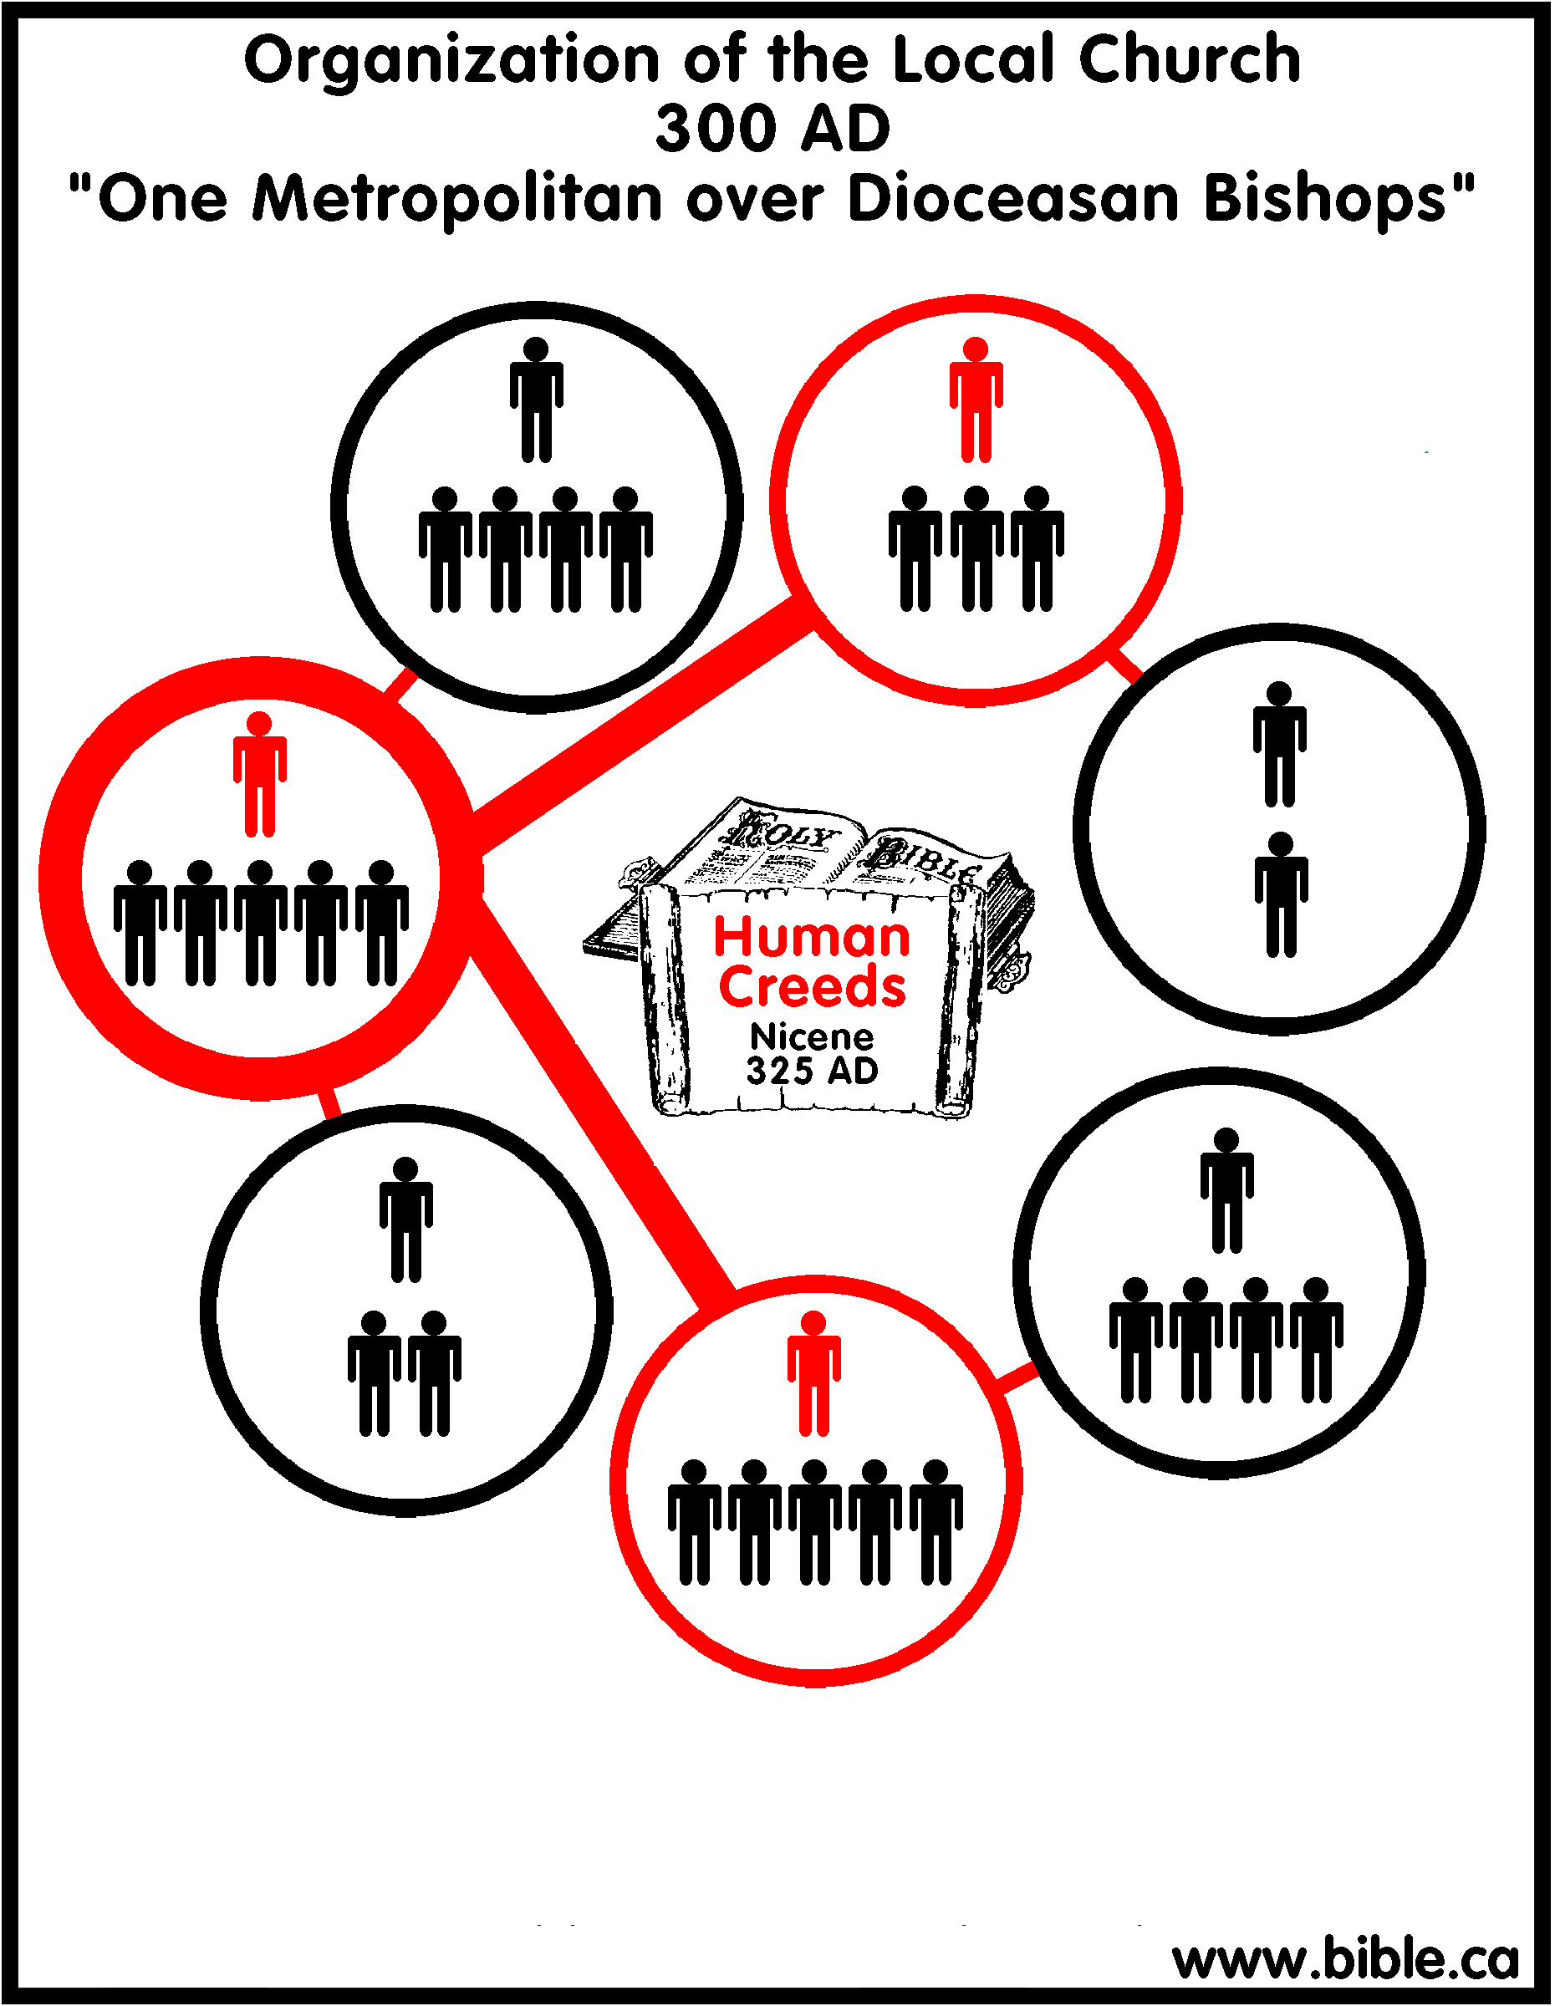

Slide 13
